Slide 1

Presentation on
Ratings Prediction
Presented By: Gagandeep Kaur Khera

Slide 2
Agenda
Introduction
Problem Statement
Problem Understanding
Importance & Benefits of Ratings Prediction
Data Analysis & Model Building Flowchart
Exploratory Data Analysis Steps
Visualizations
Data Analysis Steps Done
Model Building
Hyper Parameter Tuning and Creating Final Model
Saving the model and prediction results
Conclusion

Slide 3

Introduction
Modern E-commerce websites contain heterogeneous sources of information, such as numerical ratings, textual reviews and images. This information can be utilized to assist recommendation.
Through textual reviews, a user explicitly expresses her/his affinity towards the item. E-commerce is the daily essential of our life now-a-days. E-commerce is the platform where a seller can sell products and customer can buy the products. That means e-commerce platform connects large number of sellers to customers through online. Providing better services
to customers is one of the main keys to be successful as an e-commerce seller.
The rise in online shopping has brought a significant rise in the importance of textual customer reviews. There are thousands of review sites online and massive amounts of reviews for each and every product. Nowadays customers have changed their way of shopping. 60-70 percent of customers say that they use rating filters to filter out low rated items in their searches. The ability to successfully decide whether a review will be helpful to other customers and thus give the product more exposure is vital to companies that support these reviews, companies like Google, Amazon, flipkart and Yelp!

Slide 4

Problem Statement
In the present system, the e-commerce platform will send a feedback mail to customers after the product is delivered. The customers can give ratings out of 5, also can write down some comments/reviews about the product that he/she has purchased. Using these reviews and ratings, e-commerce platform will rate the products, which helps other people to get the insights about the quality of the product. But many times, customers would not give any ratings or reviews. How to predict the review score that a customer could give? This is the problem in e-commerce business.
There are two main methods to approach this problem. The first one is based on review text content analysis and uses the principles of natural language process (the NLP method). This method lacks the insights that can be drawn from the relationship between costumers and items. The second one is based on recommender systems, specifically on collaborative filtering, and focuses on the reviewer’s point of view. Use of the user’s similarity matrix and applying neighbours’ analysis are all part of this method. This method ignores any information from the review text content analysis.

Slide 5

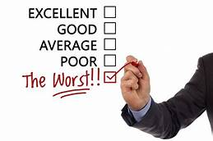
Problem Understanding
The ability to successfully decide whether a review will be helpful to other customers and thus give the product more exposure is important to companies that support these reviews, companies like Flipkart, Amazon and Yelp! The customer will make a decision to buy a product if he or she sees valuable reviews posted by others, especially the user’s trusted friend. We believe reviews and reviewers will do help to the rating prediction based on the idea that 5-star ratings may greatly be attached with extremely good reviews. It’s also agreed that different people may have different sentimental expression preferences. For example, some users prefer to use “good” to describe an “excellent” product, while others may prefer to use “good” to describe a “just so so” product. User’s rating information is not always available on many review websites.
We have a client who has a website where people write different reviews for technical products. Now they are adding a new feature to their website i.e. The reviewer will have to add stars(rating) as well with the review. The rating is out 5 stars and it only has 5 options available 1 star, 2 stars, 3 stars, 4 stars, 5 stars. Now they want to predict ratings for the reviews which were written in the past and they don’t have a rating. So, we have to build an application which can predict the rating by seeing the review.

Slide 6
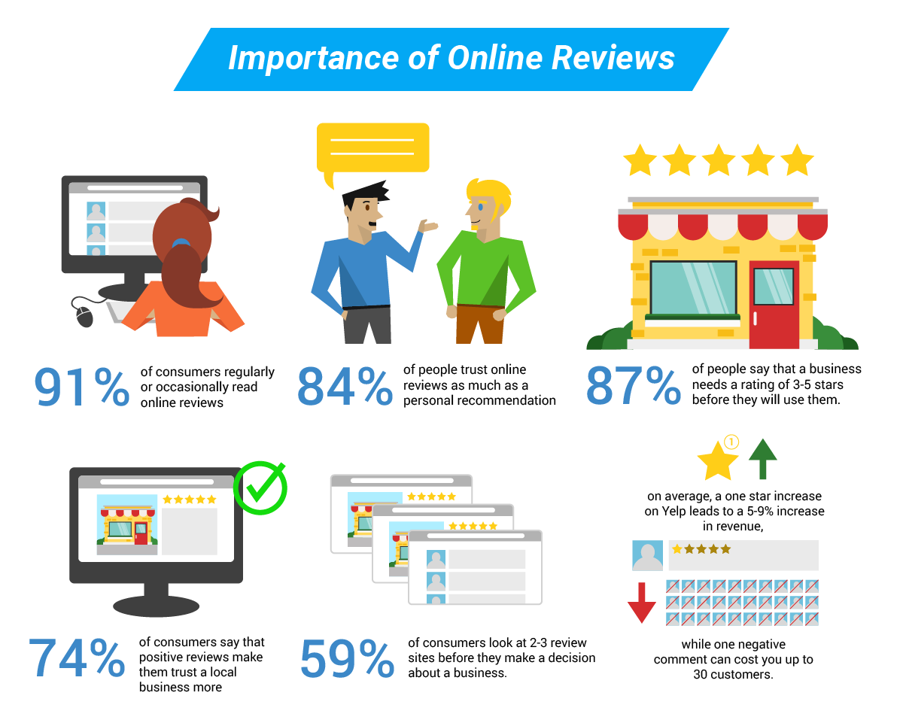

Importance & Benefits of Review Ratings Prediction

Slide 7
Data Analysis and Model Building Flowchart
Import Libraries & Collected Dataset
NLTK Text Pre-Processing
Visualizations
(EDA)
Train Test Split
Using
TF-IDF Vectorizer
Removing Skewness
Data Balancing
Model Building
Hyper Parameter Tuning
Saving the model and Predictions

Slide 8
Exploratory Data Analysis (EDA) Steps
Importing necessary libraries and loading dataset as a data frame.
Checked some statistical information like shape, number of unique values present, info, null values, value counts, duplicated values etc.
Done feature engineering and created new columns viz original_length, and Full_review_word_count.
Done text pre-processing techniques like
Text case conversion
Removing Punctuations and other special characters
Splitting the comments into individual words
Removing Stop Words
Stemming and Lemmatization
Text Standardization-Normalization
Then created new column as clean_length after cleaning the data. Checked correlation between features and label using heatmap. Removed skewness from numerical columns.
After getting a cleaned data separated feature and label and used TF-IDF vectorizer and performed Train Test split
Balanced the data using SMOTE method.

Slide 9
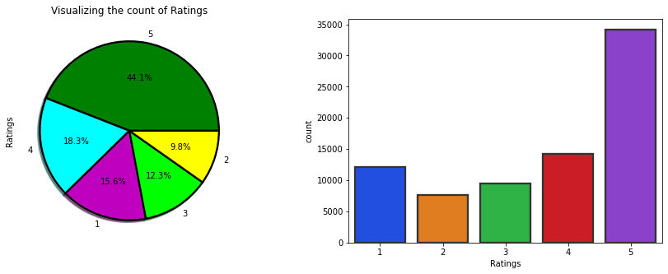
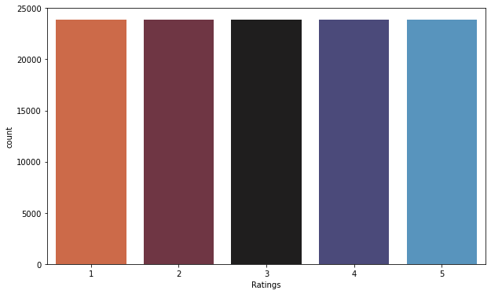
Visualizations:Count of Target Variable “Ratings”
Imbalanced Data Balanced Data
Looking at the above pie chart and count plot for our target variable "Ratings" we can say that the dataset contains the more review text rated as 5 star compared to other review ratings and very less reviews rated as 2 compared to others. Around 44% of the texts are rated as 5 and only 10% of the texts rated as 2 stars.
So, we can say that there is "imbalance problem" which we need to make it balance to build our model.
After Using SMOTE method, we can observe all the categories in the target variable "Ratings" have equal values. The class unbalancing issue has been solved.

Slide 10
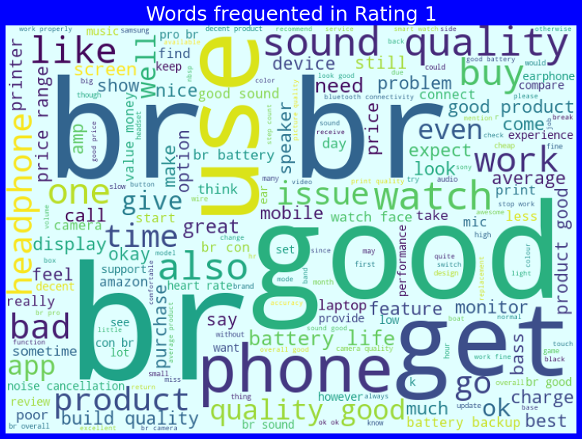
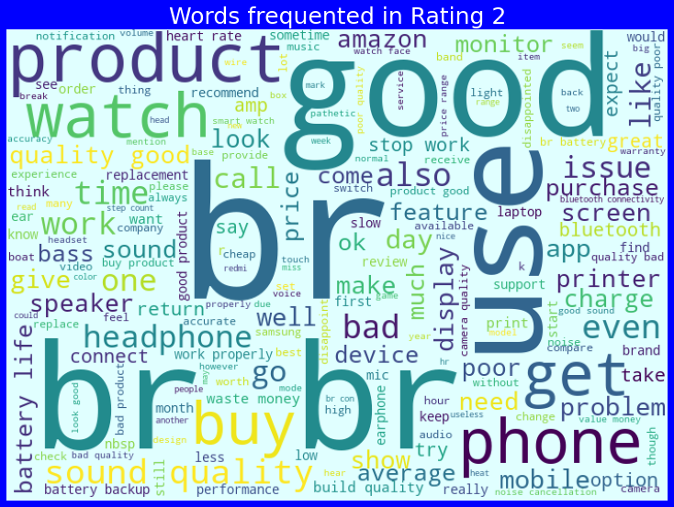
Visualizations:
WordCloud for Ratings 1 WordCloud for Ratings 2
From the above plots we can clearly see the loud words which are occurred most frequently in reviews rated as 1 star and 2 stars.

Slide 11
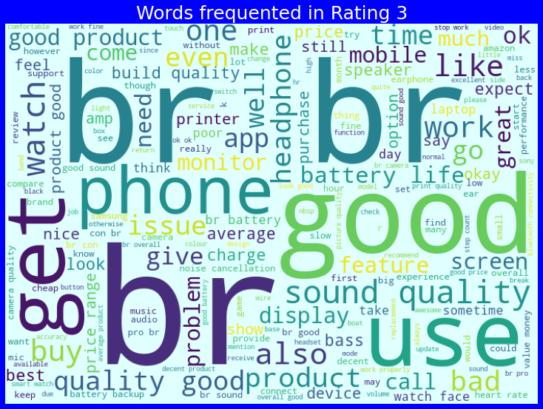
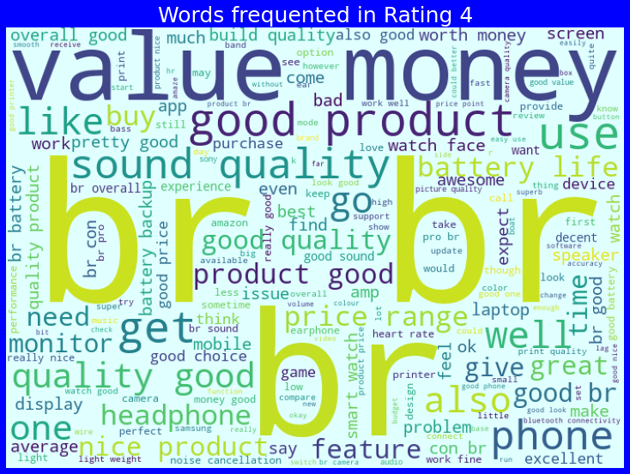
Visualizations:
WordCloud for Ratings 3 WordCloud for Ratings 4
From the above plots we can clearly see the loud words which are occurred most frequently in the reviews rated as 3 stars and 4 stars.

Slide 12
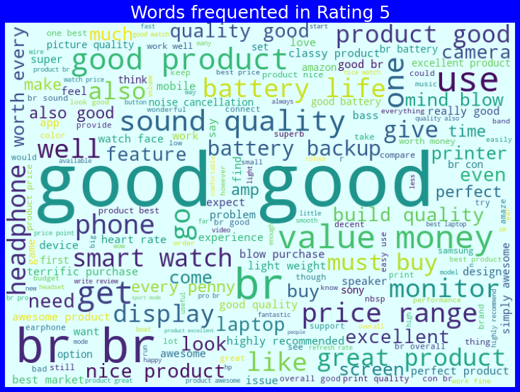
Visualizations:
WordCloud for Ratings 5
From the above plot we can clearly see the sense of words that are used more in the reviews which are rated as 5 stars.

Slide 13
Data Analysis Steps done
I have extracted and removed some features to improve data normality and linearity.
Done text pre-processing techniques like
Text case conversion
Removing Punctuations and other special characters
Splitting the comments into individual words
Removing Stop Words
Stemming and Lemmatization
Text Standardization-Normalization
Then created new column as clean_length after cleaning the data.
After getting a cleaned data used TF-IDF vectorizer. It is a common algorithm to transform text into numbers. And balanced the data using SMOTE method.
Split train and test to build machine learning models. Model building process will be shown in the further steps.

Slide 14
Model Building:
In this NLP based project we need to predict the ratings based on reviews given by customers. The target variable “Ratings” contains 5 classes hence it is Multiclass Classification Problem. I have collected data from flipkart website.
I have converted text into feature vectors using TF-IDF vectorizer and separated our feature and labels. Also, before building the model, I made sure that the input data is cleaned, balanced and scaled before it was fed into the machine learning models.
After the pre-processing and data cleaning I used independent feature for model building and prediction. The classification algorithms used on training the data are as follows:
LinearSVC
SGD Classifier
Extreme Gradient Boosting Classifier (XGB)
Decision Tree Classifier
Random Forest Classifier
Extra Trees Classifier

Slide 15
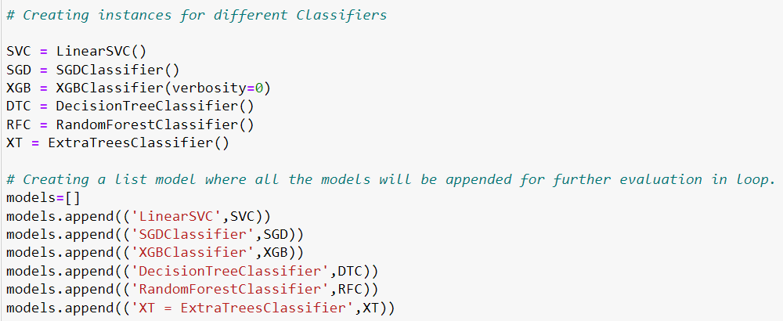
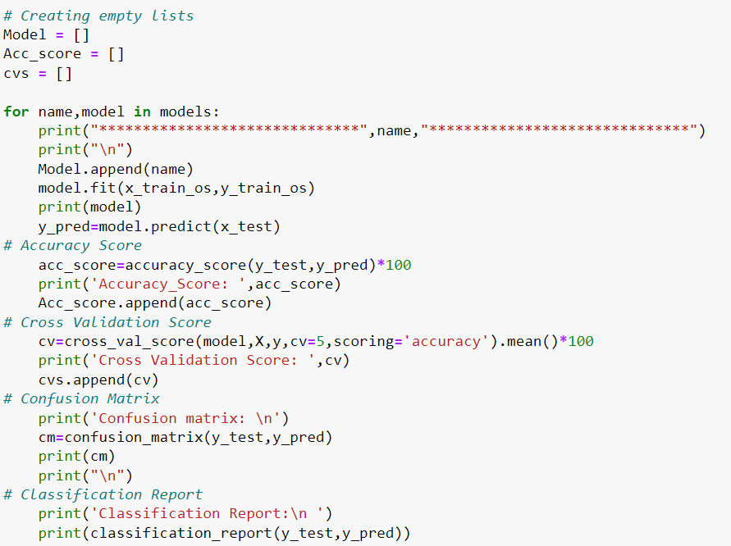
First creating instances for different classifier and then listed down the models that will be appended for further evaluation in for loop as shown.
I have created 6 different classification algorithms and are appended in the variable models. Now, let's run a for loop which contains the accuracy of the models along with different evaluation metrics.

Slide 16
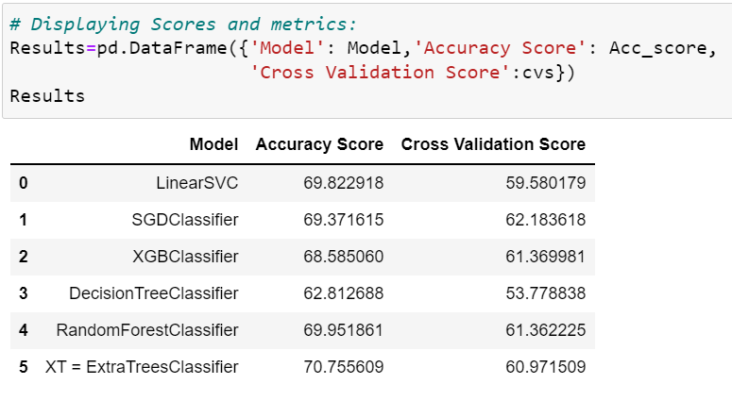
Model Selection
After creating and training different classification algorithms, we can see that the difference between accuracy and cross validation score is less for "Stochastic Gradient Descent Classifier (SGDClassifier)". On this basis I can conclude that " SGDClassifier " as the best fitting model. Now, we will try Hyperparameter Tuning to find out the best parameters and using them to improve the scores and metrics values.

Slide 17
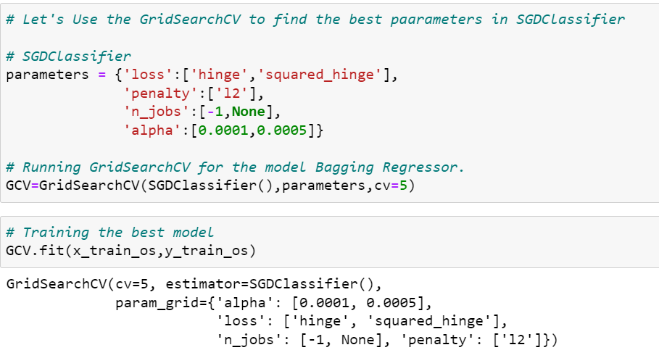
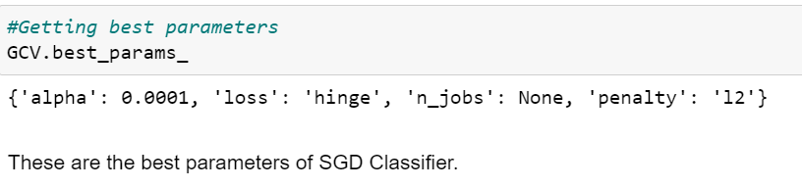
Hyperparameter Tuning:
I have used 4 SGDClassifier parameters to be saved under the variable "parameters" that will be used in GridSearchCV for finding the best output. Assigned a variable to the GridSearchCV function after entering all the necessary inputs. And we used our training data set to make the GridSearchCV aware of all the hyper parameters that needs to be applied on our best model.

Slide 18
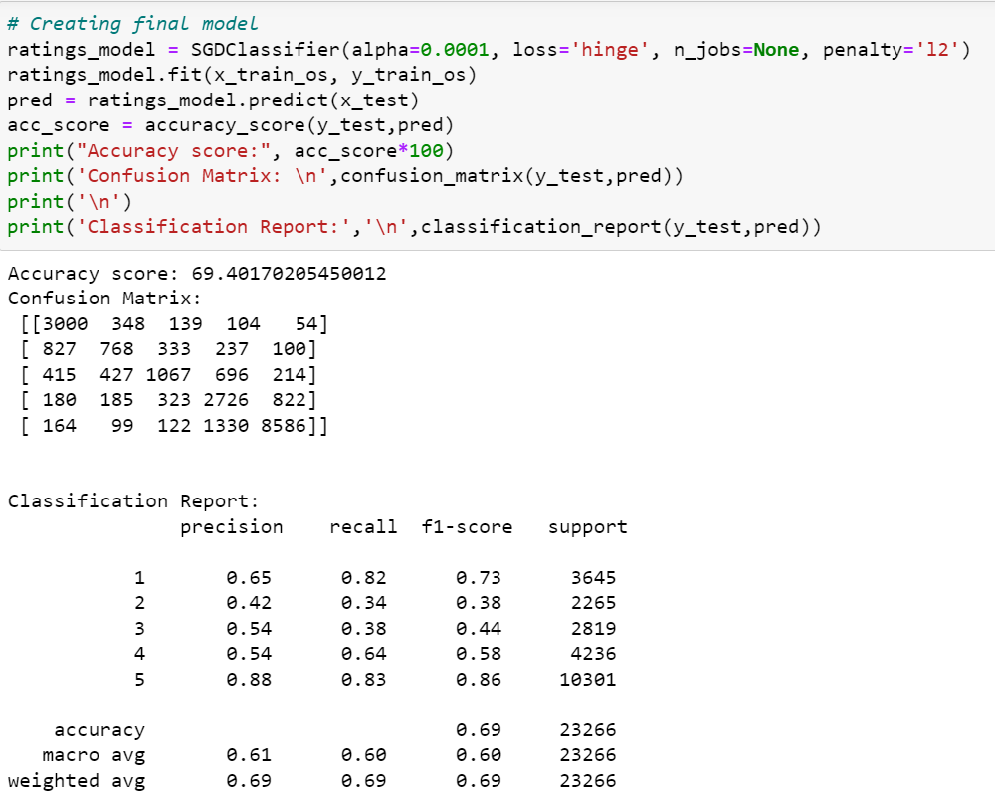
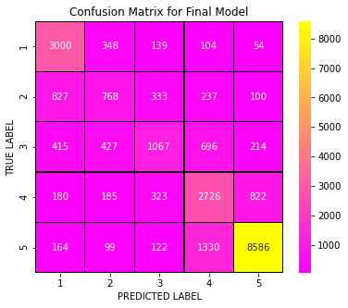
Creating Final Model After Tuning:
I have successfully incorporated the hyper parameter tuning using best parameters of SGDClassifier and the accuracy of the model has been increased after hyperparameter tuning and received the accuracy score as 69.40% which is good.
With the help of confusion matrix we can able to see actual and predicted values for the final model. And also we can understand the number of times we got the correct outputs and the number of times my model missed to provide the correct prediction

Slide 19
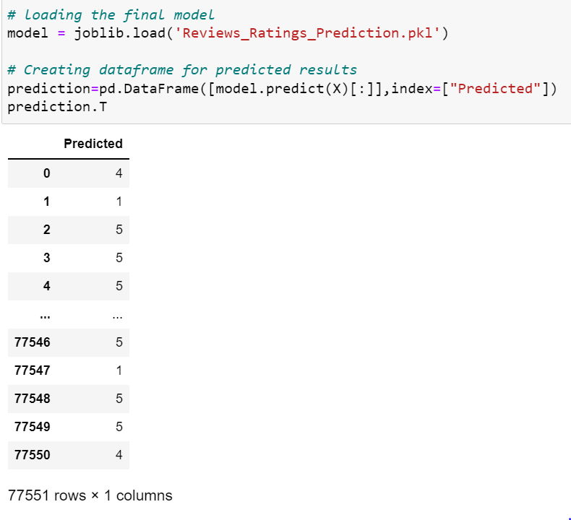
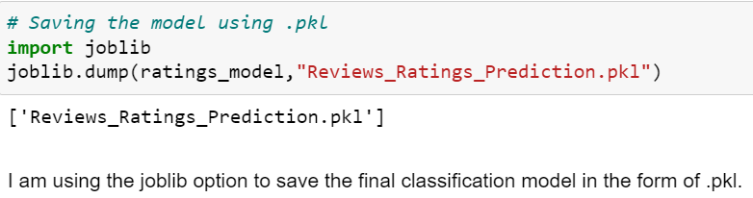

Saving The Final Model And Predicting The Results
I have saved my final best model using joblib library in .pkl format, and I have loaded the saved model to get the predictions for reviews ratings. Using classification model, we have got the predicted values for review ratings. Finally saved the predicted value of review ratings.

Slide 20
Conclusion:
From this dataset we were able to understand the idea of Natural Language Processing using machine learning models. This model helps us to understand the ratings of the products. On the basis of product review ratings one can easily buy their liked product without any fear.
First we collected the dataset from the websites www.flipkart.com and www.amazon.com which is a web platform where the people can purchase their products. The data is scraped using Web scraping technique and the framework used is Selenium.
We have mentioned step by step procedure to analyse the data. From the above analysis the below mentioned results were achieved which depicts the conditions of a reviews ratings;
With the increasing popularity of e-commerce websites more and more people consume feeds from social media and buy products on the basis of reviews and ratings of the products given by others. Applied SMOTE method to eliminate problem of imbalance.
By doing different EDA steps I have analysed the text where I got that the dataset contains more review text rated as 5 stars compared to other review ratings. Around 44% of the texts are rated as 5 and only 10% of the texts rated as 2 stars. And checked frequently occurring words in each ratings using word cloud plotting. After all these steps I have built function to train and test different algorithms and using various evaluation metrics.
Data cleaning is one of the most important steps to remove unrealistic values and unnecessary stop words.
We got SGD Classifier as best model and performed hyper parameter tuning using best parameters of SGD model and the model accuracy score increased after tuning.
After that we saved the model in a pickle with a filename in order to use whenever we require. Then we loaded the saved file and predicted the values for test data. Further we saved the predicted values data into csv file.

Slide 21
Thank You

